Slide 1
Datasheet
BL seriels（Support intrinsically safe power supply）
BL 5000X(AX3000)
File version No: V1.0
Copyright©2020 shenzhen shuotian information technology CO.,LTD，all rights reserved

Slide 2
Power and responsibility statement
No content of this publication may be reproduced, disseminated, transcribed, stored in a retrieval system, or translated into any human or computer language, in any form or by any means, without the written permission of the Company. The use of unauthorized copies of products not only infringes copyright but may prevent Shuotian Information Technology from providing accurate and up-to-date information to users and operators.
is the trademark of Shenzhen Shuotian Information Technology Co., Ltd. All other trademarks, product logos and trade names mentioned in this manual are the property of their respective owners.
The content of this manual is subject to change due to product version upgrade or other reasons. Shuotian Information Technology Co., Ltd. reserves the right to modify the content of this manual without any notice or prompt. In laws and regulations allow range, day to recognize Shuotian information technology co., LTD., in any case, all wrong because of the use of this product manual or this website content and cause of the accident, negligence, contract damage, defamation, copyright or intellectual property infringement and any special, incidental, indirect, secondary loss compensation, no any profits, data, and to compensate the loss of goodwill or anticipated savings, also does not assume any legal liability.
Security statement
Please read the safety and compatibility information of the product before powering it up.
Environmental statement
The product conforms to the design requirements of environmental protection. The storage, use and disposal of the product shall comply with the requirements of relevant national laws and regulations.
Revision record
The revision record accumulates the notes for each manual update, and the latest version of the manual contains all previous manual updates.
www.sailskywifi.com

Slide 3
Directory
1. Product characteristics·················· ··········4-5
2. Application scenarios···························6-7
3. Hardware specifications·······························8
4. Wlan Specification·································· 9
5. Receive sensitivity·······························10
6. Wlan antennas Specification·······················11
7. Power and Power Consumption···························11
8. Software features································12
9. LED·················································13
10. Physical properties································13
11. Environmental indicators····························13
12. Contact Details·······································14
www.sailskywifi.com

Slide 4
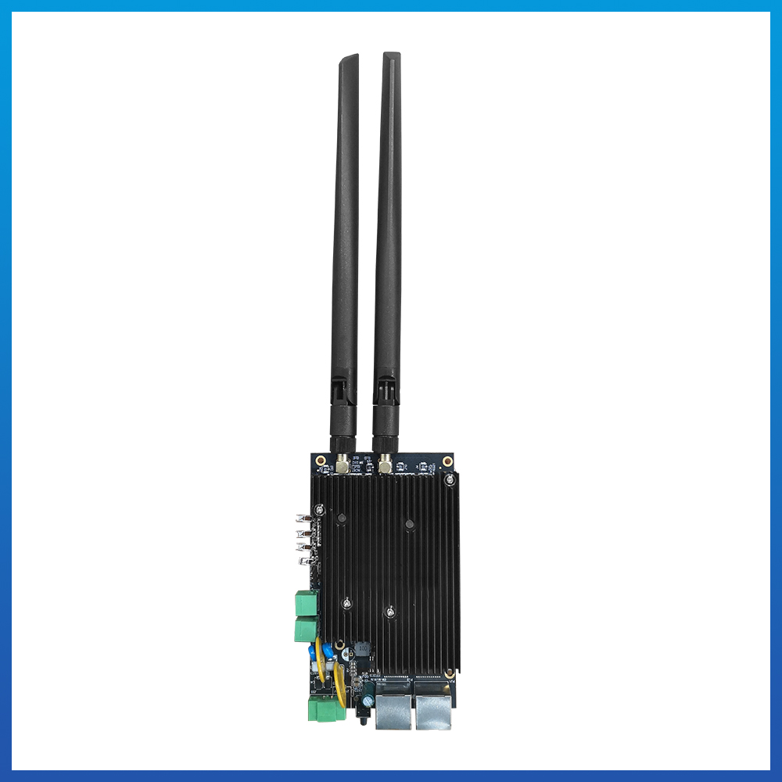
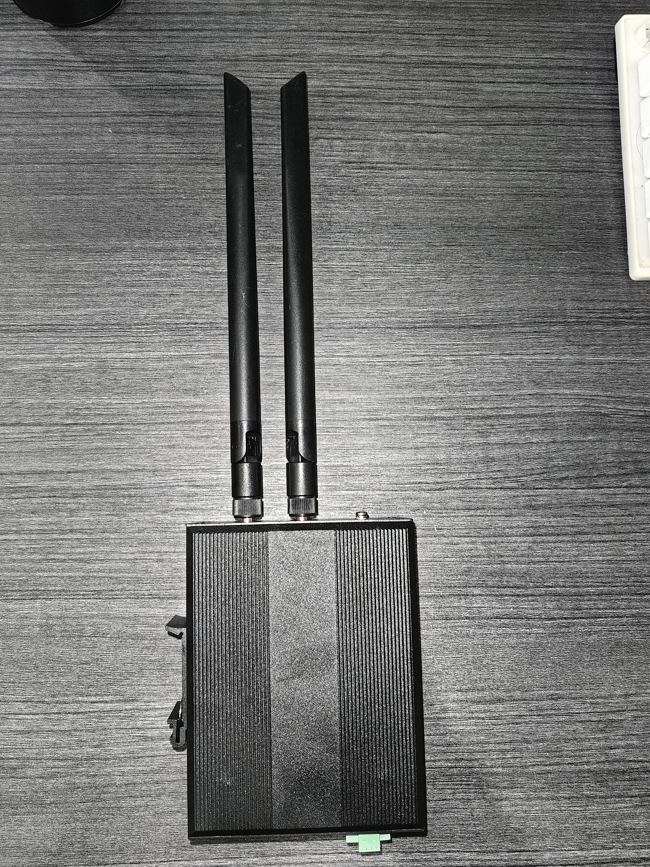
BL5000X supports omnidirectional/directional antennas, supports dual radio frequency 2.4GHz+5GHz working simultaneously, supports 2×GE electrical ports (LAN) and 1×GE electrical ports (WAN).
Support 6KV over-voltage protection of Ethernet interface, -40℃~+70℃ wide temperature operation, fully meet the requirements of industrial use;
The whole machine is designed with low power consumption, and the full-load power consumption of the WIFI single machine is ≤9W.
Whether from a technical or economic point of view, various underground applications are inseparable from the support of wifi technology, including wifi voice calls, data collection and transmission, and wireless video transmission.
BL5000X realizes wireless and fast transmission on intelligent robot inspection, monorail crane, and electric locomotive, all of which are inseparable from our technical accumulation of Wifi technology, making us gradually become a high-quality supplier of mine communication.
without housing
with housing
www.sailskywifi.com

Slide 5
01
Product characteristics
BL5000X – Wifi6AP Wireless Client
The BL5000X is a (802.11ax) standard Wi-Fi 6 client. The product adopts Qualcomm wifi6 solution architecture, which can support 2.4GHz (2×2) + 5.8GHz (2×2) dual-band to provide services at the same time. The bandwidth is 2400Mbps, and 2.4G supports 20/40Mhz with a maximum bandwidth of 574Mbps (gigabit network port).
The product hardware design meets the intrinsic safety requirements, and the reliable power multi-level protection and port protection design can ensure that the BL5000X wireless product can work in a harsh industrial control environment for a long time, and at the same time solve the unsafe hidden danger of high power consumption.
Ultra-miniaturized design concept, terminal interface, stable and shock-resistant, can be built in robots, cameras, hand-held remote controls, explosion-proof boxes, AGV and other equipment.
Can be widely used in industrial applications. Mine intrinsic safety. Mobile robot inspection. High-bandwidth communication and other industrial applications.
In terms of performance, BL5000X has superior wireless reception performance, strong anti-interference, and supports millisecond-level seamless and fast handover roaming technology. The new wireless technology has changed the iteration from traditional mines to intelligent ones, and there are few specialized low-latency roaming technologies. With the support of manufacturers, the BL5000X client and BL6000X base station can be used together to provide low latency and high bandwidth compatibility, low cost, and long distance. It is more suitable for communication environments such as coal mines, warehousing, and robot inspection. It is widely used in complex industrial wireless communication systems.
www.sailskywifi.com

Slide 6
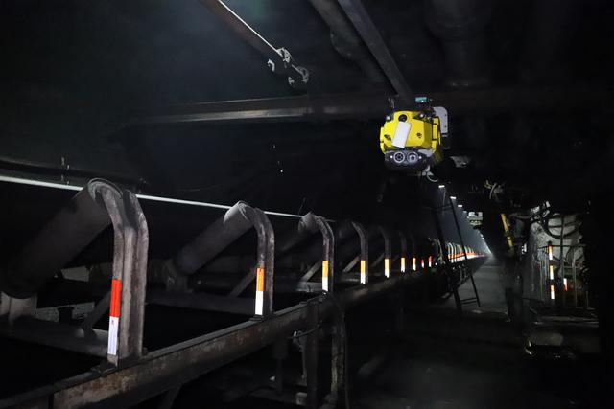
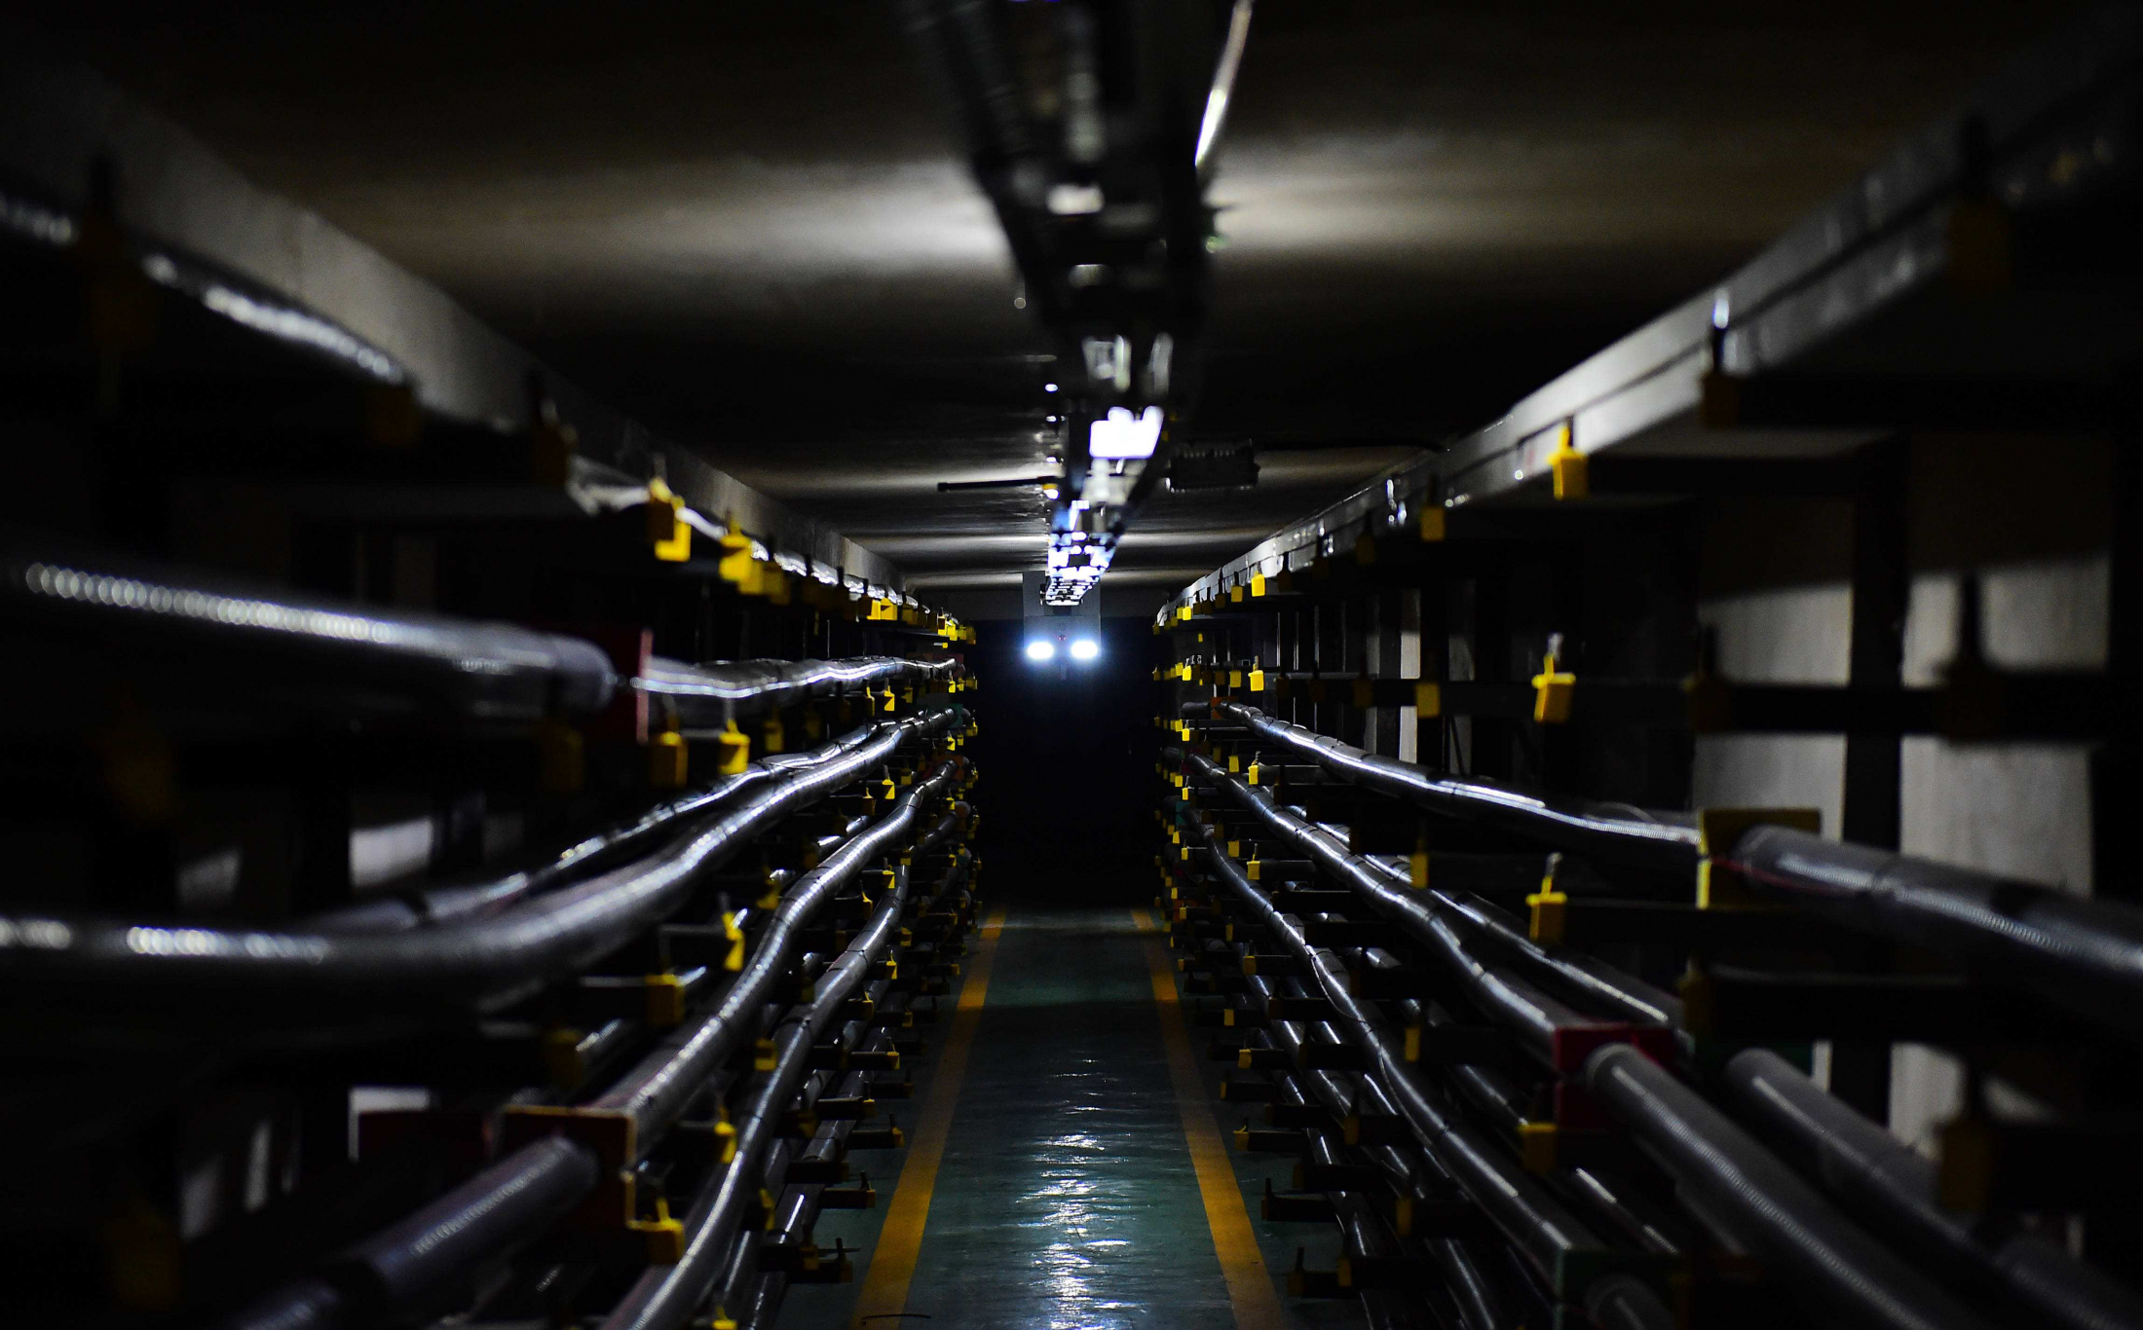
01
Application scenarios
1. Smart mine
2.corridor
www.sailskywifi.com

Slide 7
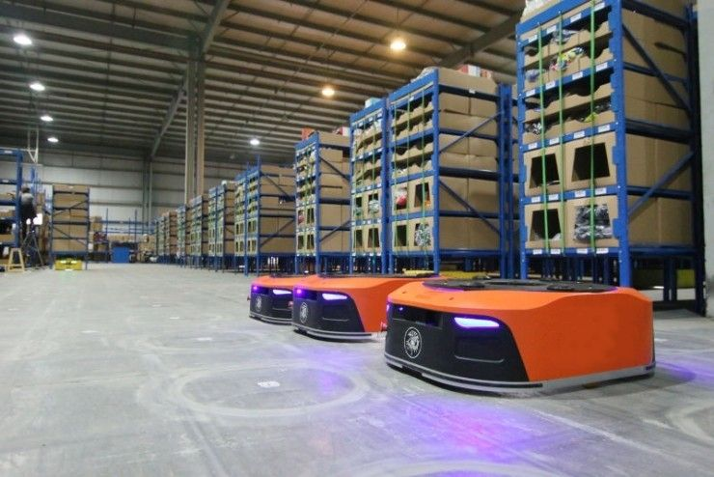
3 .Power inspection
4. AGV inspection robot for warehouse logistics
www.sailskywifi.com

Slide 8
04
warehouse logistics
Hardware Configuration
Model | BL5000X
Chipset | IPQ5018+6102+8337
Memory | 256MB
Flash | 128MB+16MB
Size With housing | 128x93x35mm
Bare board size | 124*71*2mm
Unit Weight | 0.2kg(Board)
Operating mode | Router/AP/Mesh
Reset button | reset button（Press and hold for 10 seconds to restore the factory default configuration）
Status Indicator | LEDs x 4 (Power/LAN/2.4G/5G)
SMA Antennas | 2 combined interface, can be connected to directional/omnidirectional antenna
Power supply | 9-24V Phoenix terminal and DC interface power supply
Interface | 1 10/100/1000M bps adaptive LAN
 | 1 10/100/1000M bps adaptive WAN
 | 1*DC 1 *Phoenix terminal
 | 2*SMA Antenns Port
 | 1 * RS485; 1 * RS232
www.sailskywifi.com

Slide 9
05
Wlan Specification
WLAN Specification±2 dB | 2.4GHz | 5GHz | 5GHz
11 b (1Mbps) | 24 | - | -
11 b (11Mbps) | 24 | - | -
11 g (6Mbps) | 24 | - | -
11 g (54Mbps) | 23 | - | -
11 a (6Mbps) | - | 24 | -
11 a (54Mbps) | - | 22 | -
HT20(MSC 0/8) | 24 | 24 | -
HT20(MSC 7/15) | 23 | 22 | -
HT40(MSC 0/8) | 24 | 24 | -
HT40(MSC 7/15) | 23 | 22 | -
VHT80 256QAM MCS0 |  | 23 | -
VHT80 256QAM MCS9 |  | 19 | -
VHT80 1024QAM MCS0 |  | 22 | -
VHT80 1024QAM MCS11 |  | 17 | -
www.sailskywifi.com

Slide 10
06666
Receive sensitivity
Receive sensitivity（ each）±2 dB
 | 2.4GHz | 5GHz | 5GHz
11 g (6Mbps) | -94 | - | -
11 g (54Mbps) | -78 | - | -
11 a (6Mbps) | - | -93 | -
11 a (54Mbps) | - | -77 | -
HT20(MSC 0/8) | -92 | -91 | -
HT20(MSC 7/15) | -75 | -74 | -
HT40(MSC 0/8) | -89 | -88 | -
HT40(MSC 7/15) | -72 | -70 | -
VHT20 256QAM @ 3/4 Code Rate | - | -90 | -
VHT20 256QAM @ 5/6 Code Rate | - | -71 | -
VHT40 256QAM @ 3/4 Code Rate | - | -88 | -
VHT40 256QAM @ 5/6 Code Rate | - | -66 | -
VHT80 256QAM @ 3/4 Code Rate | - | -86 | -
VHT80 256QAM @ 5/6 Code Rate | - | -61 | -
VHT80 1024QAM MCS11 | - | -51 | -
www.sailskywifi.com

Slide 11
07
WLAN Aantennas Specification
WLAN Antennas Specification
Frequency | 2.4~2.4835GHz and 5.15~5.85GHz
Antennas Specification | Different antenna configurations are optional 1. Omnidirectional antenna 2. Directional antenna
Polarization | dual polarization
Antenna efficiency | ≧50% @ 2.4~2.4835GHz ≧50% @ 5.15~5.85GHz
08
Power and Power Consumption
Power and Power Consumption
IPQ5018 | 3.5
QCA6102 | 1.2
DDR | 1.4
8337 | 1.2
2.4G PA 2*2 | 4
5G PA 2*2 | 3.5
Total （W） | 15
www.sailskywifi.com

Slide 12
Software features
Working frequency | 2.4GHz,5.8GHz
Transfer Protocol | Support 2.4G:802.11b/g/n , 5.8GHz：802.11a/n/ac/ax MIMO
Transfer Rate | 5 GHz: 2402 Mbps (802.11ax, HE160) 2.4 GHz: 574 Mbps (802.11ax)
Modulation mode | Support 50ms fast switching
Penetrate | Support KVR roaming protocol, transparent transmission standard
wireless throughput | 950Mbps
Systems
Systems status | current connection status |  | Client mode, KVR roaming protocol
Static IP |  | Independent intranet IP, isolated from transmission IP
Wireless setting |  | Virtual SSID
List of Wireless Features
Mode |  | Router,Access piont,client,mesh mode,
KVR |  | Support 802.11k, 802.11v, 802.11r protocol intelligent fast roaming, switching time ≤ 50ms
802.11mode chose |  | 802.11b/g/n 802.11ac/ax
Channel settings |  | Manual/Auto (Automatically select the best channel)
Transfer rate setting |  | Manual/Auto
Output power control |  | User-defined output power (unit: dBm)
Software upgrade |  | Update the latest software
Reset |  | Restore current settings to factory mode

Slide 13
09
LED
LED
4 LEDs to indicate the operating status of the product (configurable via GPIO)
10
Physical properties
Physical properties
Working environment | Working temperature: -40°C～70°C
 | Storage temperature: -50°C～80°C
 | Humidity: 5%～95% (non-condensing)
11
Environmental indicators
Environmental indicators
Altitude | -1000m~5000m
Working pressure | 53kPa~105kPa
Power consumption | WIFI stand-alone full load power consumption≤9W
www.sailskywifi.com

Slide 14
Welcome to visit us for more info or quotation:
SHENZHEN SHUOTIAN INFORMATION TECHNOLOGY CO.,LTD
2/F, Building E, Huasai Industrial Zone, Bantian Street,Longgang District, Shenzhen,Guangdong Province, ChinaChinaWeb：www.sskycn.com
E-mail：Natalie@sskycn.com
Tel/WhatsAPP/Wechat: +86-13760857118
Copyright©2020 shenzhen shuotian information technology CO.,LTD，all rights reserved

